Slide 1
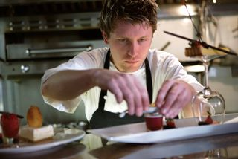
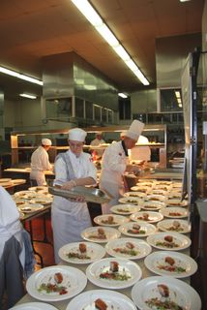
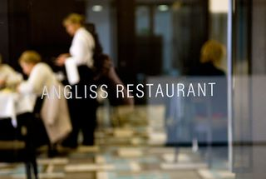
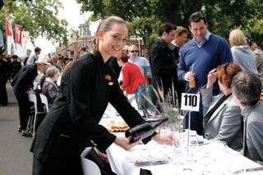
SELECT CATERING SYSTEMS
D1.HCA.CL3.07
Notes:
Trainer welcomes students to class.

Slide 2

Select catering systems
This Unit comprises three Elements:
Establish enterprise requirements for a catering system
Evaluate catering systems
Recommend a catering system
Notes:
Trainer advises trainees this Unit comprises three Elements, as listed on the slide explaining:
• Each Element comprises a number of Performance Criteria which will be identified throughout the class and explained in detail
• Trainees can obtain more detail from their Trainee Manual
• At times the course presents advice and information about various protocols but where their workplace requirements differ to what is presented, the workplace practices and standards, as well as policies and procedures must be observed.

Slide 3

Assessment
Assessment for this unit may include:
Oral questions
Written questions
Work projects
Workplace observation of practical skills
Practical exercises
Formal report from employer or supervisor
Notes:
Trainer advises trainees that assessment for this Unit may take several forms, all of which are aimed at verifying they have achieved competency for the Unit as required.
Trainer indicates to trainees the methods of assessment that will be applied to them for this Unit.

Slide 4
Establish enterprise requirements for a catering system
Performance Criteria for this Element are:
Research catering requirements the enterprise requires
Identify the enterprise constraints in selecting a system
Notes:
Trainer identifies for trainees the Performance Criteria for this Element, as listed on the slide.
Class Activity – General Discussion
Trainer leads a general class discussion on establishing enterprise requirements for a catering system asking questions such as:
Why is it important to establish enterprise requirements for a catering system?
What might these requirements be?
How would you determine what the requirements are? What action would you undertake? What research would you do?
Why is it important to determine the constraints which apply to the selection of a catering system for a venue/kitchen?
What do you think might be examples of enterprise constraints in this regard?

Slide 5
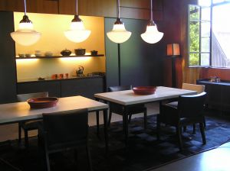
Research catering requirements the enterprise requires
Businesses which may need to select a catering system:
Hotels, taverns and bars
Restaurants and cafes
Private, sporting and other clubs
School, universities and other educational institutions
Hospitals, hospices and aged care facilities
(Continued)
Notes:
Trainer identifies a variety of commercial businesses that produce and serve food and which may need to select a catering system:
Hotels, taverns and bars
Restaurants and cafes
Private, sporting and other clubs
School, universities and other educational institutions
Hospitals, hospices and aged care facilities

Slide 6

Research catering requirements the enterprise requires
Workplace cafeterias and canteens
Military/defence catering
Prisons
Residential caterers
In-flight and other transport catering
Meetings, Incentives, Conferences/conventions, and Exhibitions (MICE) catering
Notes:
Trainer continues identifying a variety of commercial businesses that produce and serve food and which may need to select a catering system:
Workplace cafeterias and canteens
Military/defence catering
Prisons
Residential caterers
In-flight and other transport catering
Meetings, incentives, conferences/conventions, and exhibitions (MICE) catering.

Slide 7
Research catering requirements the enterprise requires
Main aims of the unit are:
Determination of catering system requirements for an organisation
Evaluation of operational aspects of different catering systems
Selection of a catering system which suits the characteristics and needs of the organisation being considered
Notes:
Trainer advises the focus of the unit is on evaluating and selecting an integrated production, distribution and service catering system to meet the food production needs of a catering organisation stating the main aims address:
Determination of catering system requirements for an organisation
Evaluation of operational aspects of different catering systems
Selection of a catering system which suits the characteristics and needs of the organisation being considered.

Slide 8

Research catering requirements the enterprise requires
Need for this unit will arise when:
You are called on to modify an existing food production and food service system in a business
The opportunity arises to build and install a new catering system for a venue or organisation
Notes:
Trainer tells students they will have a need for this unit when:
Called on to modify an existing food production and food service system in a business
The opportunity arises to build and install a new catering system for a venue or organisation.

Slide 9

Research catering requirements the enterprise requires
This unit is aimed at:
Senior managers
Who operate with significant autonomy
With responsibility and authority to make strategic management decisions
Notes:
Trainer suggests the unit is aimed at:
Senior managers – such as including executive chefs and catering managers
Who operate with significant autonomy – that is, they can make decisions with little or no reference to others in the organisation
Who are responsible for making a range of strategic management decisions – relating to the direction of the business and ways to attain the identified goals of the organisation.

Slide 10
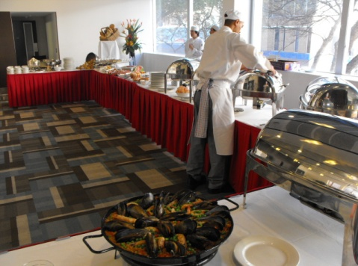
Research catering requirements the enterprise requires
‘Catering system’ = an overall food production and food service system where all components are integrated into a cohesive, effective and efficient operation.
Examples include:
‘Conventional’
‘Cook-chill’
(Continued)
Notes:
Trainer explains ‘Catering system’ refers to an overall food production and food service system where all components/elements are integrated into a cohesive, effective and efficient operation providing options such as:
‘Conventional’ – a system where food is cooked fresh and served at the time
‘Cook-chill’ – where food is cooked and stored under refrigeration for short-term or long-term storage

Slide 11
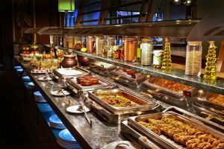
Research catering requirements the enterprise requires
‘Cook-freeze’
‘Commissary’
Assemble-serve
Notes:
Trainer providing examples of catering system options:
‘Cook-freeze’ – where food is cooked and frozen for later re-thermalisation and service
‘Commissary’ – featuring transportation of pre-prepared food to satellite kitchens for re-heating and service
Assemble-serve – where pre-prepared food is portioned, plated and served: no cooking or other processing is required..

Slide 12

Research catering requirements the enterprise requires
Foundation skills required of those with responsibility for selecting a catering system:
Communication to underpin consultation with others
Critical thinking skills
Initiative and enterprise skills
High level literacy skills
(Continued)
Notes:
Trainer notes people who undertake the task of selecting catering systems should posses the following skills to underpin their research, evaluation and allied activities:
Communication skills to consult on system requirements with key personnel – such as:
Other management-level personnel
Boards of Directors
Owners
Government agencies/authorities
Equipment/system providers and suppliers
Critical thinking skills – to:
Analyse and evaluate all aspects of the organisation’s catering operation
Select a catering system which best suits its characteristics and needs
Initiative and enterprise skills – to:
Determine courses of action
Maintain motivation and achieve required objectives/outcomes
Integrate workplace needs with capacity and capability of various catering systems
Select a system with the best cost benefits
High level of literacy skills to:
Read and interpret detailed product specifications for different catering systems
Research product options for and suppliers of catering systems
Read and interpret recipes and menus

Slide 13

Research catering requirements the enterprise requires
High level numeracy skills
Planning, self-management and organisational skills
Problem-solving skills
Teamwork and interpersonal skills
Communication skills to facilitate questioning and idea sharing
Research skills
Notes:
Trainer continues identifying required foundation skills required by those who select catering systems:
High level numeracy skills to:
Calculate wastage issues and impacts on profitability
Determine cost-benefit analyses
Review complex financial information
Calculate costs of production and costs for installing a new system
Planning, self-management and organising skills – to:
Access and sort information required to evaluate different catering systems
Coordinate a timely and efficient selection process
Organise personal work and research efforts
Problem-solving skills – to:
Identify organisational operational constraints
Select a system which complements operations
Teamwork and interpersonal skills – to:
Invite and coordinate the input of others in the organization
Facilitate liaison
Encourage contributions from, and engagement with, others
Communication skills – to:
Enable questioning of others
Facilitate exchange of ideas and information
Research skills – to:
Investigate relevant topics
Capture information
Follow-up information as required.

Slide 14

Research catering requirements the enterprise requires
Foundation knowledge is required of:
Methods of cookery
All stages of the food production process
HACCP and FSPs
(Continued)
Notes:
Trainer introduces foundation knowledge required by those who are charged with selecting catering systems:
Methods of cookery – for all major food types, including preserved and packaged foods for various types of hospitality and catering organisations
Comprehensive details of all food production processes – see Class Activity below
Hazard and Critical Control Points (HACCP) – with reference to:
General principles and practices
Specific requirements of the Food Safety Plan/Program (FSP) as it applies to the host venue/kitchens
Class Activity – Question and Answer
Trainer asks students to identify stages in the food production process.
Suggested answers
Receiving – of food into the premises
Undertaking mise en place – organisation of ingredients and equipment/utensils prior to preparing/producing food
Preparing food – ready for cooking/processing
Cooking – the application of a variety of cooking options to produce menu items
Post-cooking storage – of foods for service, display and refrigerated or frozen storage for later use
Reconstituting foods – returning (for example) dehydrated or concentrated food to usable condition, or its natural/original state
Re-heating of previously cooked food – referred to as ‘re-thermalisation’
Serving food – for internal/on-site eating and/or for take-away consumption

Slide 15
Research catering requirements the enterprise requires
Culinary terms
Costing, yield testing and portion control
Nutritional knowledge
Relevant local or host country legislation
Notes:
Trainer continues identifying foundation knowledge required by those who are charged with selecting catering systems:
Culinary terms – commonly used in the industry related to food production systems
Costing, yield testing and portion control in quantity food production
Nutritional knowledge – as applicable to:
General food stuffs
Specific needs of the workplace for identified customer/target groups
Local/host country legislation – as it applies to:
Food handling and food safety
Workplace safety and health
Industrial relations.

Slide 16

Research catering requirements the enterprise requires
Research methods are necessary to:
Learn about catering system options
Provide a fact-based basis for analysing and evaluating systems
Make a decision on the best catering system option for a given context
Notes:
Trainer advises ‘Research methods’ refers to ways in which to obtain the necessary information/data required to:
Learn about catering system options
Analyse/evaluate the options available
Decide on the best system to meet the identified needs/requirements of your operation.

Slide 17

Research catering requirements the enterprise requires
Research methods can include:
Meeting with and talking to management
Reading printed and online information
(Continued)
Notes:
Trainer presents examples of research methods:
Meeting with management of the venue – to:
Confirm need for the process to select a catering system – and obtain necessary authorisations to proceed with the research
Identify plans they have for the future direction of the business – which are likely to impact the selection of a catering system.
Future directions which may influence a decision could include:
Plans for expansion or contraction of the business
Plans to focus on an a new/different target market
Plans to re-position the venue in the marketplace
Plans to reduce or increase staff levels
Identify operational and acquisition constraints you are expected to operate under – see section 1.2
Assessing published information on different catering systems – by:
Visiting relevant websites
Reading relevant articles in industry magazines and journals
Reading reports from industry peak bodies and relevant government agencies and authorities
Reading product information brochures and equipment/system specifications
Class Activity – Handouts
Trainer distributes and discusses sample articles and other printed materials on catering systems.

Slide 18
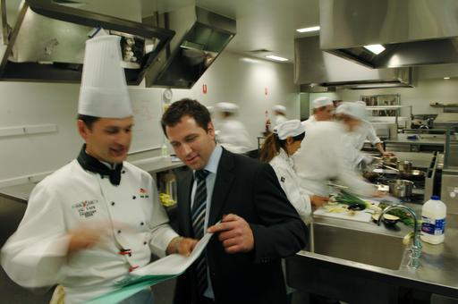
Research catering requirements the enterprise requires
Talking to food equipment and systems suppliers
Discussing food production and service needs with workplace personnel
(Continued)
Notes:
Trainer continues presenting examples of research methods:
Communicating with suppliers of catering systems – and:
Providing information about the business and its plans and operational requirements
Seeking product/system information
Determining options available – together with:
Price
Availability
Capacity
Having representatives visit and view your operation – so they gain first-hand knowledge of your venue and its requirements
Discussing food production and service needs with colleagues – to:
Identify enterprise and operational requirements – see ‘Research topics’ on following slides
Determine preferences for catering system deliverables – and rationale for same
Involve relevant others in the project – and thereby generate interest, enthusiasm and commitment to the process and final selection
Class Activity – Guest Speaker
Trainer arranges for sales representative from local food equipment/system provider to attend and:
Discuss catering system options and availability
Compare and contrast systems
Provide informational brochures, price lists and similar.

Slide 19
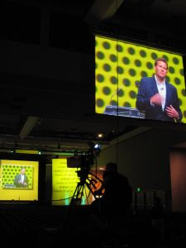
Research catering requirements the enterprise requires
Visiting other industry operations and operators
Viewing your own food production and service operations
Attend relevant industry events, conferences and seminars
Notes:
Trainer continues presenting examples of research methods:
Visiting other industry operators – and:
Viewing their facilities
Talking to operational staff who use the catering systems which are in place
Speaking with management about their impressions of effectiveness, efficiency and system performance and problems
Viewing your current operation – and:
Inspecting and measuring the facilities
Talking to staff and watching staff at work
Noting bottle-necks and other problem areas
Attending relevant industry ‘food production and food service’ meetings and events – such as
Conferences
Seminars
Product launches
Symposiums.
Class Activity – Excursion
Trainer arranges excursion to a local food outlet so students can:
View operations and facilities
Talk to management and staff
Take notes on what they see.

Slide 20
Research catering requirements the enterprise requires
A wide range of topics should be addressed when researching catering systems.
Attention must be paid to covering:
Inputs to the systems
Outputs from the system
Notes:
Trainer advises a wide range of topics need to be researched to determine enterprise requirements for a catering system highlighting research should address:
Inputs to the system – ingredients, power/energy, equipment, labour and similar
Outputs from the system – menu items, volume, timing, waste and similar.

Slide 21
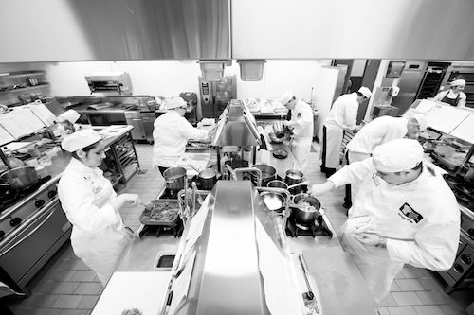
Research catering requirements the enterprise requires
Research topics when determining enterprise catering requirements:
Nature of the operation:
Where food is to be prepared and produced
General nature of the business
(Continued)
Notes:
Trainer presents research topics when seeking to establish enterprise catering requirements for the selection of catering systems.
Nature of the operation
This should determine:
Whether food is to be:
Produced and served at the same point
Produced in the one kitchen for service at multiple points/outlets in the same venue
Produced at a central kitchen for distribution for transportation/distribution to multiple points/outlets for service at these off-site locations – centralised food production using a number of supporting satellite kitchens to re-constitute and re-thermalise foods
The general nature of the business – such as (for example):
Hotel, fine dining
Work canteen
Institutional catering.

Slide 22

Research catering requirements the enterprise requires
The menu to be produced and served:
Type of menu
Menu items
Time of day
(Continued)
Notes:
Trainer continues presenting research topics when seeking to establish enterprise catering requirements for the selection of catering systems.
The menu
There is a need to identify:
The type of menu – is it:
Rotating/cyclical, as is the case in most hospitals or institutions?
A la carte – featuring a need for cooked to order meals?
Buffet – requiring smorgasbord style service?
Functions menus – requiring quantity food production and service?
Menu items being offered/proposed – for example:
Identification of dishes and recipes
Determination of cooking styles
Nomination of number of courses
The intentions of those who plan the menus for the venue/outlets
The time of day the menu is for – such as, for example:
Breakfast, lunch and/or dinner
Supper.
Class Activity – Handouts
Trainer distributes a range of menus and discusses how these potentially impact catering system and/or equipment required.

Slide 23
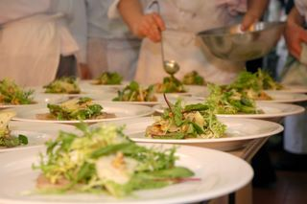
Research catering requirements the enterprise requires
Production volume:
Average expected trade and service requirements
Demand at peak times
Variations by session, day or season
For special times, events or occasions
(Continued)
Notes:
Trainer continues presenting research topics when seeking to establish enterprise catering requirements for the selection of catering systems.
Production volume
This relates to demand for food and service and may be related to:
Standard/normal trading and service requirements
Demand at peak times
Variations in demand on a sessional, daily, weekly or seasonal basis
Impact of events/functions on normal food production and service
Nomination of figures/projections (‘number of meals served’) for different trading times/occasions on, as appropriate to the organisation:
An hourly basis
A sessional basis
A daily basis.

Slide 24
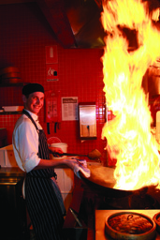
Research catering requirements the enterprise requires
Service areas:
Location – on-site and or off-site?
Size
Existing facilities
Transport required
Legislated and ‘best practice’ requirements
(Continued)
Notes:
Trainer continues presenting research topics when seeking to establish enterprise catering requirements for the selection of catering systems.
Service areas
Research needs to identify:
The area/s from which service needs to occur – on- and off-site, as applicable: physical relationship between food production kitchen and service points/outlets – in terms of geography/distance and time to travel
Size of service area
Facilities currently existing in service area/s
Transport (vehicles and staffing) required to move food from production area to service points
Legislated requirements and ‘best practice’ protocols for safe food transportation of hot, refrigerated and/or frozen food

Slide 25
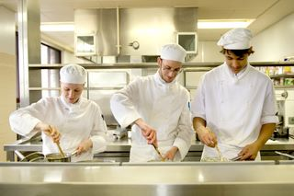
Research catering requirements the enterprise requires
Storing and holding requirements:
Hot and cold – demand; facilities and equipment required; location
Amount of space required
Existing facilities
(Continued)
Notes:
Trainer continues presenting research topics when seeking to establish enterprise catering requirements for the selection of catering systems.
Storage and holding requirements
Research may be related to identifying:
Hot and/or cold holding – of prepared food for display and/or service, in terms of:
Demand for (capacity) same
Type of equipment required – bain maries, warmers, cabinets
Location and type of existing facilities
Amount of storage space required for:
Refrigerated storage – of raw and prepared foods
Frozen storage – of raw and prepared foods
Type and capacity of existing storage facilities.

Slide 26

Research catering requirements the enterprise requires
Nutritional and dietary requirements:
Nutritional requirements for individual dishes/foods in terms (as appropriate) for serve sizes, vitamins, energy and other
Special needs to cater for identified health-related, cultural, religious and lifestyle needs
(Continued)
Notes:
Trainer continues presenting research topics when seeking to establish enterprise catering requirements for the selection of catering systems.
Nutritional and dietary requirements
Research should identify:
If there is a need for certain nutritional requirements to be met for:
Certain dishes
Nominated outlets
Identified foods.
Exactly what the nutritional requirements are – in terms of, for example:
Serve sizes
Vitamins
Energy
Special need to cater for nominated dietary requirements as they apply, for example, to:
Health-related issues – such as:
Diabetic meals
Low-salt and/or low-fat meals
Allergy-related menu items
Cultural and/or religious requirements
Lifestyle preferences.
Class Activity – Discussion
Trainer leads discussion on:
Examples of how health-related special needs can influence menu and food requirements
Examples of how cultural special needs can influence menu and food requirements
Examples of how religious special needs can influence menu and food requirements
Examples of how lifestyle special needs can influence menu and food requirements.

Slide 27

Research catering requirements the enterprise requires
Relevant timeframes:
Opening times and trading hours
Meal times
Delivery ‘lead times’ for ingredients
Transportation times – from kitchen to service point/s
(Continued)
Notes:
Trainer continues presenting research topics when seeking to establish enterprise catering requirements for the selection of catering systems.
Relevant timeframes
Research should indicate:
Opening times/trading hours of commercial premises – for all service points/outlets
Scheduled service times for meals – in operations such as hospitals, prisons and schools
Lead times – from ordering of raw ingredients/food from suppliers to delivery of food into the premises/kitchen stores
Delivery/transportation times – from central kitchen to satellite kitchens/other service points.

Slide 28
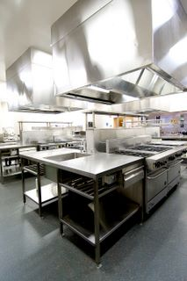
Research catering requirements the enterprise requires
Available space:
Does new/revised catering need to fit into an existing space?
Details of current layout
Details of room for expansion – or need for reduction of size of facility
(Continued)
Notes:
Trainer continues presenting research topics when seeking to establish enterprise catering requirements for the selection of catering systems.
Available space
Research may be related to:
Whether the new/revised system is required to fit within an existing space – or if there is scope to expand production and service areas into additional space
Details of current layout – of existing systems, equipment and facilities including utilities
Amount of:
Additional space available for expansion
Space which is required to be saved as a result of the change/up-date to the catering system.

Slide 29

Research catering requirements the enterprise requires
Customer requirements:
Definition and classification of who customers are
Description of their identified needs, wants and preferences
Obtaining their feedback and input
(Continued)
Notes:
Trainer continues presenting research topics when seeking to establish enterprise catering requirements for the selection of catering systems.
Customer requirements
Research should address:
Defining and identifying ‘customers’ or consumers
Describing their identified needs, wants and preferences
Obtaining feedback/input from existing and potential/target.

Slide 30

Research catering requirements the enterprise requires
Ingredients purchased:
Type
Style and nature – fresh; pre-/fully-prepared; semi-prepared
(Continued)
Notes:
Trainer continues presenting research topics when seeking to establish enterprise catering requirements for the selection of catering systems.
Ingredients purchased
In this regard research should address:
The type, style and nature of the foods bought by the kitchen to produce menu items. This is relevant and important as;
It has implications for the equipment and staff needed to (as appropriate):
Store the food
Prepare the food
Process the food
It needs to align with other factors/issues – such as:
Required quality standards
Customer preferences
Value-for-money
Image and market position of the organisation

Slide 31
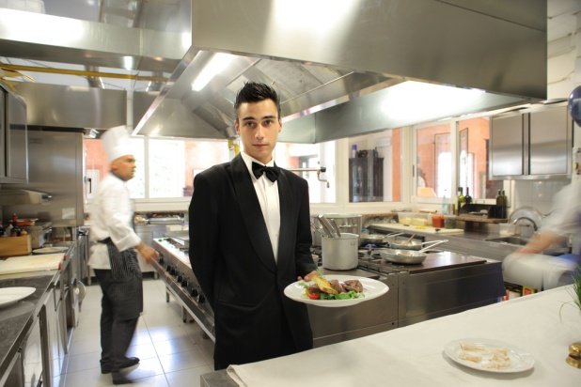
Research catering requirements the enterprise requires
Enterprise practices and standards:
Food purchasing options
‘Public statements’ made by the business
SOPs
Quality standards
Capacity for change’
Strategic advantages enjoyed by the business
(Continued)
Notes:
Trainer continues presenting research topics when seeking to establish enterprise catering requirements for the selection of catering systems.
Enterprise practices and standards
Research may be related to:
Understanding options for buying different ingredient/raw materials – and/or pre-prepared and ready-made items
Knowing the contents of public statements the business makes about itself – in terms of:
Mission statement
Vision statement
Value statement
Understanding Standard Operating Procedures (SOPs) and relevant policies for the operation
Knowing the kitchen (or individual service point/outlet) quality standards for:
Individual menu items
Food service to customers
Identifying the capacity for change within the business – and:
The procedures to achieve such change
The resources available to enable/support such change
Determining any strategic or competitive advantages enjoyed by the business – in terms of (for example):
Unique selling points – products and/or services that other businesses do not have
Information, experience and/or expertise
Industry knowledge
Internal systems
Supplier contracts
Industry contacts and/or partners.
Class Activity – Handouts
Trainer distributes sample Mission, Vision and Value Statements and discusses their relationship to and influence regarding food production and service.

Slide 32

Research catering requirements the enterprise requires
Utilities:
What utilities are required?
Access and availability
Continuity and reliability
Cost
Notes:
Trainer continues presenting research topics when seeking to establish enterprise catering requirements for the selection of catering systems.
Research should address:
Availability of:
Electricity
Gas
Water
Continuity and reliability of supply
Cost
Access.

Slide 33

Research catering requirements the enterprise requires
Research data – ‘secondary’ data:
Is ‘existing’ data
Can be obtained by:
Reading reports and articles
Reviewing internal statistics, information and reports
Manipulating existing data
(Continued)
Notes:
Trainer introduces research data with reference to ‘secondary’ data stating:
Secondary data is data/information that already exists.
It can be obtained by:
Reading reports, articles and books
Reviewing internal business trading information, performance statistics and operational reports
Manipulating existing data.
Class Activity – Handouts
Trainer distributes and discusses samples of secondary data which may be used (researched and referred to) as part of the research process.

Slide 34

Research catering requirements the enterprise requires
‘Primary’ data:
Is new/original data
Can be obtained via:
Asking questions, talking to people
Observation
Market research activities
You should capture both ‘secondary’ and ‘primary’ data.
Notes:
Trainer introduces research data with reference to ‘primary’ data stating:
Primary data is information which is new/original data.
It is generated as a result of:
Asking questions and talking to people
Observing practice and operations
Market research activities – such as surveys, questionnaires and focus groups.

Slide 35
Research catering requirements the enterprise requires
Data can also be ‘qualitative’ or ‘quantitative’.
Qualitative = ‘soft’ data which relates to:
Descriptions of things
Explanation of preferences or behaviours
Anything which cannot be measured
Notes:
Trainer introduces concept of ‘qualitative’ and ‘quantitative’ data stating:
Qualitative data (also known as ‘soft’ data) relates to:
Descriptions of things – such as:
“A large venue with extensive facilities serving a wide variety of target markets”
“The kitchen features conventional service and uses equipment which was installed in the venue after being removed from the organisation’s previous property in Singapore”
Explanations of preferences and behaviour – detailing:
Why people have selected certain systems/equipment for their food production and service
Reasons why businesses do not use certain systems/technologies in their food production/service
What other organisations think about nominated food production and food service options.
Any issues which cannot be measured/quantified – essentially these issues revolve around answers to ‘Why?’ questions:
“Why did you do this?”
“Why did you not do that?”
Class Activity – Handouts
Trainer distributes and discusses sample qualitative data explaining its relevance to the research process.

Slide 36
Research catering requirements the enterprise requires
Quantitative = ‘hard’ data which relates to :
Statistics, numbers and figures
Costs, times speed, temperatures
Demand, capacity and volume
Percentages
Must have both ‘hard’ & ‘soft’ data.
Notes:
Trainer discusses ‘quantitative’ data stating:
Quantitative data (also known as ‘hard’ data) is statistical in nature.
It includes:
Numbers/figures – relating to topics such as:
Costs – of equipment, installation and estimates for service/maintenance/repairs
Time – to deliver, install and commission systems
Speed – of processing food; delivering meals; cooking dishes
Temperature – of cooking and holding equipment
Demand levels – for meals
Capacity and volume – of individual items of equipment/systems for delivering or producing menu items
Percentages – such as:
Food cost percentage – the amount represented by the cost of food in the selling price of a menu item
Labour percentage – the amount of labour/wages in the selling price of a dish
Return on Investment – the profit the venue obtains based on money invested
Class Activity – Handouts
Trainer distributes and discusses sample quantitative data explaining its relevance to the research process.

Slide 37
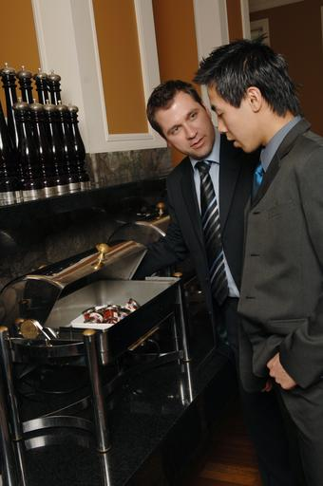
Research catering requirements the enterprise requires
Those who could be encouraged to be involved in the research and decision-making process:
Senior management and or Head Office
Owners
Contractors and sub-contractors
Accountants and finance
Specialist catering consultants
(Continued)
Notes:
Trainer stresses need for involving others in the research and decision making process when selecting catering systems identifying those who may be involved/asked to participate:
Senior management – including:
Venue manager/s
Director or CEO
The Board of Management, Board of Directors or the Executive
Head Office representatives
Owners
Contractors and sub-contractors – especially where aspects of catering have been outsourced
Accountants and financial management staff/CFO – including external lenders
Specialist consultants – with expertise in catering/food production and service

Slide 38
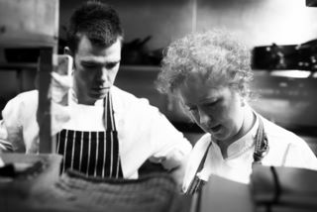
Research catering requirements the enterprise requires
Executive chefs
Food and Beverage Managers
Function, Event or Banquet managers
Menu planners
Dieticians and nutritionists
(Continued)
Notes:
Trainer continues identifying those who may be involved in the research and decision making process for selecting a catering system:
Head chefs/Executive chefs and section chefs
Food and Beverage managers/supervisors and/or Foodservice Directors
Function, Event and Banquet managers
Menu planners
Dieticians and nutritionists

Slide 39

Research catering requirements the enterprise requires
Personnel (managers and staff) from various internal departments
Suppliers
Local authorities and agencies
Customer representatives
Notes:
Trainer continues identifying those who may be involved in the research and decision making process for selecting a catering system:
A combination of management-level employees and operational staff from a range of internal departments/divisions and workplace groups/teams with responsibility for:
Sales and Marketing
HR
Purchasing
Training and Development
Food safety
Workplace health and safety
Maintenance
Representatives from suppliers – who provide system elements (technology and equipment)
Officers and inspectors from local health/food safety authorities
Representative(s) from target customer/guest group.

Slide 40

Identify the enterprise constraints in selecting a system
Possible constraints:
Financial constraints:
There are always limits to spending
Need to discuss availability with management
May need to source alternate funding sources
(Continued)
Notes:
Trainer highlights the need to identify enterprise constraints as part of the research process when selecting a catering system identifying a range of possible constraints.
Financial constraints
In relation to financial constraints:
There will always be limits on what you can spend – there is never total financial freedom
It is vital to talk to management to determine the amount of money available for the project – they may be able/prepared to:
Move money between budgets to allocate more money
Raise more funds than originally allocated
You may be required to acquire the new system in different ways due to short-falls in cash, lack of availability of credit or cash flow issues – for example, you may be required to:
Lease items/systems rather than purchase them outright
Seek financing from suppliers
Source funds from ‘other’ financial institutions or investor sources
Request grants/subsidies from government agencies/bodies

Slide 41

Identify the enterprise constraints in selecting a system
Must comply with finance-related policies and procedures
A ‘phased’ introduction may be required
Must identify and consider all costs
(Continued)
Notes:
Trainer continues discussing financial constraints:
You will always be required to align with internal finance-related policies and procedures – which (for example) can include:
Need to obtain multiple written quotations from different suppliers – rather than only getting one quote form one supplier
Need to negotiate price – as opposed to simply ‘accepting’ prices quoted
Need to negotiate terms of payment – which would address:
Delaying/deferring dates by which various payments (deposits, initial payment, progress payments, final payment) to suppliers have to be made
Reducing amount of deposit and/or other payments
Need to negotiate other contracted terms – such as negotiating more favourable warranties and guarantees
Need to tender out a contract for the work to be done
Lack of sufficient funds at the present time may necessitate a phased introduction of a new/revised catering system spread over a given time period (months or years) – as opposed to ‘full and immediate’ introduction
Attention must be paid to all costs the enterprise will incur as a result of the introduction of a new/revised catering system – in addition to possible ‘opportunity cost’ and purchase/leasing costs these may relate to:
Lost revenue while kitchen is closed for renovation
Cost of removing old systems/equipment – note it may be possible to sell some of the old equipment so this must also be factored into overall considerations and calculations
Revisions to SOPs, workplace policies, plans, checklists and standard recipes
Training
Insurance
Service and maintenance.

Slide 42
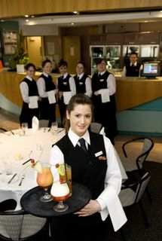
Identify the enterprise constraints in selecting a system
Staff constraints:
Need to adhere to labour budget
Need to include labour costs for transportation
Consider need for ‘skilled’ staff
Factor in number and ability of current staff
(Continued)
Notes:
Trainer discusses staff constraints:
Staff constraints
In relation to staff (human resources) constraints you will need to consider may include:
Labour budget for the food production and food service operation – this is always a concern and is traditionally calculated as a given percentage of expected revenue/sales.
The system you decide on must not require staff levels which exceed labour budget parameters.
Labour cost to transport/distribute prepared food – in systems where satellite/remote kitchens will be used to re-constitute/re-heat food
Number of skilled staff required – to operate the system: the need for ‘skilled’ staff introduces potential additional expenses in terms of:
Recruitment
Remuneration – higher skilled staff attract higher pay rates
Training
Current skill levels of existing staff – in relation to issues such as:
Need to recruit additional staff
Need to train staff
Need to multi-skill employees.

Slide 43
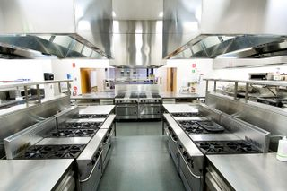
Identify the enterprise constraints in selecting a system
Space constraints:
New system usually has to fit into existing space
Use of extra space results in ‘opportunity cost’
Must match areas to food flow
Food production must support and facilitate food service and customer access
(Continued)
Notes:
Trainer discusses space constraints:
Space constraints
‘Space’ constraints refer to the amount of room you have available for the new/up-dated catering system.
Considerations include:
In most/many cases where there is an existing system you will be expected to fit the new/revised system into the existing space – while it is usually acceptable to use less than the current amount of space, it is generally not acceptable (or possible) to occupy more space
Use of more space results in added ‘opportunity cost’ – that is, the loss of the extra space is a cost to the business because it cannot be used to generate income (through, for example, setting extra tables to enable the selling/service of extra meals)
The need to position the food production area/s to integrate efficiently and effectively with other stages of the flow of food within the kitchen/venue – in relation to activities such as:
‘Goods in’ to the kitchen – receival of goods from suppliers
Storage of ingredients – in relation to:
Dry goods storage
Refrigerated storage
Frozen storage
Food preparation – prior to production/cooking of food
Production/cooking – of menu items
Post-cooking storage
Re-constitution of menu items/foods – where applicable
Re-thermalisation – where applicable
Transport/distribution to other outlets
The need to locate food production facilities to facilitate:
Food service
Access by customers and wait staff

Slide 44
Identify the enterprise constraints in selecting a system
Compliance constraints:
Host country food safety legislation
HACCP-based Food Safety Plans
Industry ‘best practice’
(Continued)
Notes:
Trainer discusses compliance constraints.
Compliance constraints
In relation to compliance constraints you need to ensure the catering system/option you choose will:
Enable compliance with host country food safety legislation
Complies with all requirements of any HACCP-based Food Safety Plan/Program used by the kitchen – or enables a new HACCP-based FSP to be developed to reflect the new/revised catering system
Reflect industry ‘best practice’ in terms of:
Food handling practices, procedures, policies and protocols
Food production and food service
Class Activity – Guest Speaker
Trainer arranges for local Health/Food Inspector to attend and:
Discuss requirements for selecting a catering system which they deem important in relation to food safety
Documentation which may need to be completed as part of the process of installing a new/up-dated catering system
Detail the inspection process required before a new//up-dated catering system can become operational
Provide tips in relation to selecting a new/up-dated catering system.

Slide 45

Identify the enterprise constraints in selecting a system
Timing constraints – may relate to:
Need for system to be fully-operational by a given date
Need for certain stages to be competed by set dates
Need for money to be spent by a nominated time
(Continued)
Notes:
Trainer discusses possible timing constraints:
Timing constraints
The decision to select, install and commission a new/revised catering system is usually subject to some form of time-related limits.
Considerations may relate to:
The need to the new/revised system to be fully-functional by a given date – so advanced bookings can be catered for and catering contracts can be fulfilled
The need for certain stages of the project to be completed by nominated dates – for example, specific timelines may be set for:
Research and decision making
Releasing Request For Tender (RFT) documentation
Awarding the contract
The need for money to be spent by a given date – in order:
For expenditure to qualify for taxation claims
That grants are used by the date required.

Slide 46
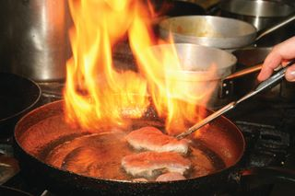
Identify the enterprise constraints in selecting a system
Existing equipment constraints:
New equipment may have to integrate with existing equipment
New technologies may have to integrate with existing equipment/systems
New equipment may need to fit into the space left by old equipment which has been removed
(Continued)
Notes:
Trainer discusses possible existing equipment constraints:
Where the project requires you to up-date the catering system in an existing venue (as opposed to introducing a totally new system) there will be constraints in relation to:
Ensuring new or up-dated equipment integrates with other existing items
Making sure new technologies are compatible with other technologies which are currently in place
New equipment will physically fit in the space left when old items have been removed.

Slide 47

Identify the enterprise constraints in selecting a system
It is simpler to select a catering system for a new business than to up-date an existing one – there is:
Tendency to stick with existing system
Reduced willingness to change layout, systems, procedures or allocation of space
(Continued)
Notes:
Trainer continues discussing possible existing equipment constraints:
It is relatively easier to have to select a catering system for a new venture/enterprise than it is to select a catering system to up-date an existing workplace/business.
When dealing with an existing business several factors have emerged over time as being difficult factors to address – for example:
There is a general tendency to want to stick to what is known – this often results in (simply) an up-dated version of the previous system being selected.
In practice the ‘old’ approach is retained while using more modern equipment.
There is often a reluctance to get rid of some existing items, equipment and practices – the dominant thinking is often:
“We cannot afford to do away with that”.
or
“We will make do with that item because it still works: we will replace it when it breaks down”.
There is a reduced potential/capacity or predisposition for:
Changing the layout of the operation
Altering the allocation of space for the system.
When working to select a catering system for a brand new facility there is commonly more scope for flexibility in what can be chosen: the selection of the catering system, of course, should occur as part of the planning process for the new kitchen/business so relevant plans can be prepared to guide construction and installation.

Slide 48

Identify the enterprise constraints in selecting a system
When choosing a system for a new operation:
There is more potential for considering other opportunities and larger volumes
Allows total design of food flow
There is greater willingness for new thinking
Notes:
Trainer continues discussing possible existing equipment constraints:
Working to choose a system for a new operation:
Provides the potential to look at broader opportunities and larger volumes – which can introduce the potential for including satellite kitchens/service points supported by a main/central kitchen
Allows you to design the total flow of food in the kitchen – from delivery of food into the kitchen, through storage, preparation and cooking, to service and post-production storage and/or distribution to other service points/satellite kitchens
Generally sees management and other decision makers more well-disposed to new thinking and ideas – in terms of food production options and techniques, different food service strategies and more innovative ways of doing business.

Slide 49
Identify the enterprise constraints in selecting a system
Key Selection Criteria = non-negotiable aspects of the selection process.
KSC may relate to:
Catering requirements
Enterprise constraints
(Continued)
Notes:
Trainer introduces concept of Key Selection Criteria stating:
Key Selection Criteria (KSC) are non-negotiable aspects in relation to selection of a catering system which must be met. KSC may relate to:
Catering requirements – for example:
The system must be able to produce X meals per session
Certain types/styles of food must be able to be produced
Nominated standards must be achieved – for example, in terms of:
Quality – taste and appearance
Nutrition
Food safety
Enterprise constraints – for example:
The identified budget must not be exceeded
The system must fit within the existing kitchen space
The system must be fully-operational by a given date.

Slide 50

Identify the enterprise constraints in selecting a system
All factors identified as KSC must form the basis for:
Evaluation and analysis of systems available
Recommendations made
Notes:
Trainer continues discussing Key Selection Criteria stating:
All factors identified as KSC must form the basis for:
Evaluation of catering systems/alternatives being considered – see later slides
Recommendations for a catering system – see later slides.

Slide 51
Summary – Element 1
When establishing enterprise requirements for a catering system:
Apply suitable research methods to the process
Meet and talk with management and operational staff
Obtain and read published information on systems
(Continued)
Notes:
Trainer provides a recap of the Element asking questions to check trainee understanding and responding to questions from trainees, as required.

Slide 52
Summary – Element 1
Meet with equipment and system suppliers
Visit other venues and kitchens
View and review your own operation
(Continued)
Notes:
Trainer provides a recap of the Element asking questions to check trainee understanding and responding to questions from trainees, as required.

Slide 53
Summary – Element 1
Determine nature and requirements of the kitchen or venue and available space
Identify menu items and necessary production levels
Specify holding and storage requirements and available space
(Continued)
Notes:
Trainer provides a recap of the Element asking questions to check trainee understanding and responding to questions from trainees, as required.

Slide 54
Summary – Element 1
Locate service outlets as well as available space
Nominate dietary and nutritional requirements
Detail power, energy and water needs
(Continued)
Notes:
Trainer provides a recap of the Element asking questions to check trainee understanding and responding to questions from trainees, as required.

Slide 55
Summary – Element 1
Determine food production stages involved
Consider existing enterprise standards and practices
Obtain a mix of data including ‘soft’ and ‘hard’ as well as secondary and primary data
(Continued)
Notes:
Trainer provides a recap of the Element asking questions to check trainee understanding and responding to questions from trainees, as required.

Slide 56
Summary – Element 1
Involve relevant others in the process
Identify and quantify all constraints and limitations
Determine Key Selection Criteria
Notes:
Trainer provides a recap of the Element asking questions to check trainee understanding and responding to questions from trainees, as required.

Slide 57
Evaluate catering systems
Performance Criteria for this Element are:
Identify a range of alternative catering systems
Evaluate agreed enterprise requirements against systems
Notes:
Trainer identifies for trainees the Performance Criteria for this Element, as listed on the slide.
Class Activity – General Discussion
Trainer leads a general class discussion on evaluating catering systems by asking questions such as:
What is meant by a ‘conventional’ catering system?
What do you know about the ‘cook-chill’/’cook-freeze’ catering system?
What do you think is the difference between a ‘central’ kitchen and a ‘satellite’ kitchen?
What is meant by the ‘re-thermalisation’ catering system?

Slide 58
Identify a range of alternative catering systems
Four catering system classifications (Unklesbay, 1977) which will be discussed are:
Conventional
Ready-prepared
Commissary
Assembly-serve
Notes:
Trainer identifies four catering system classifications/options available today were first described in 1977 by Unklesbay (Foodservice systems: Product flow and microbial quality and safety of foods) and will be explained/described in detail.
The four systems are:
Conventional or traditional
Ready prepared
Commissary
Assembly/serve.

Slide 59
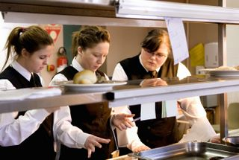
Identify a range of alternative catering systems
There is a link between food production and food service which can be illustrated and explained by a ‘continuum of food processing’ where:
Some kitchens buy raw ingredients and produce menu items from this
Some kitchens buy in a mix of raw ingredients, pre-prepared items and ready-made items
Some kitchens purchase only fully-made, pre-portioned foods
Notes:
Trainer adds Unklesbay emphasised the link between food production and food service using a continuum of food processing to illustrate and explain:
Some venues buy raw ingredients and prepare all their meals/foods on-site
Many kitchens buy a combination of raw ingredients, pre-prepared items and ready-made foods and prepare their menus from this mix
Some service points buy/receive food which is all fully-prepared and/or pre-portioned – and only need to re-heat and/or plate it for service with little or no requirement for ‘processing’.

Slide 60
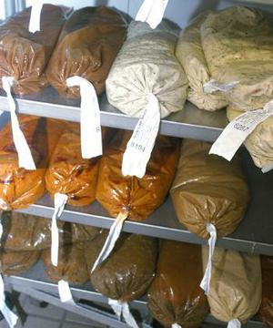
Identify a range of alternative catering systems
Use of pre-prepared and ready-made foods is increasing:
To save labour costs
As quality of the products continues to improve over time
Through the use of food specifications which can detail precisely how raw materials are to be prepared prior to delivery
Notes:
Trainer advises in practice the use of pre-prepared and ready-made foods is increasing in many kitchens:
To save labour costs – because using pre-prepared and ready-made items saves on preparation time
As the quality of these products continues to improve
Through the use of detailed food purchasing specifications – detailing (for example) how meat is to be trimmed, the size of pieces, the thickness of cuts and the weight of items.
Class Activity – Handouts
Trainer distributes and discusses samples of food purchasing specifications showing how kitchens can use them to have certain products pre-prepared by a supplier and hence save labour cost/preparation time.

Slide 61
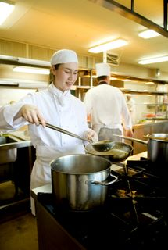
Identify a range of alternative catering systems
‘Conventional’ catering system:
Is ‘cook-and-serve’
Food is prepared/cooked at the time and served hot or cold
Food is not prepared today for service at a later date
Is the most common system
Food is cooked and served at same location
Notes:
Trainer introduces the Conventional catering system stating:
The ‘conventional’ catering system is ‘cook and serve’.
In this system the food is prepared/cooked and served at the time, either hot or cold depending on type of menu item.
Food is not prepared today for service at a later date
This style of service is the most commonly used system and features preparation and cooking of the food at the same location where the food is served.
Class Activity – Excursion
Trainer arranges visit to a venue using the Conventional catering system so students can:
Observe food production
View facilities
Watch food service
Talk to management
Talk with staff.

Slide 62
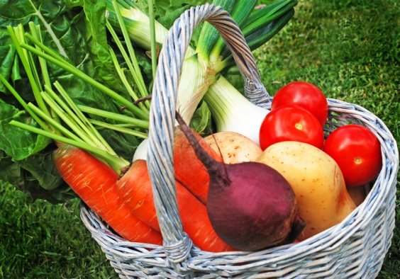
Identify a range of alternative catering systems
Food bought for use in the Conventional system may be:
Raw ingredients
Pre-prepared food
Ready-made items
Notes:
Trainer notes the food which is processed/cooked may be purchased across all points of the food processing continuum as:
Raw ingredients – requiring full processing (preparation and cooking)
Pre-prepared food – requiring no or partial preparation prior to cooking/inclusion in menu items
Ready-made items – only needing to be cut/portion-controlled, plated and served.

Slide 63

Identify a range of alternative catering systems
Menu items for the Conventional system are either:
Cooked to order
Cooked prior to service and held for service:
Hot – such as wet dishes and roasts (dishes requiring long preparation/cooking times)
Cold – such as ice cream, cold entrées and desserts
Notes:
Trainer states menu items for the Conventional system are either:
Fully cooked to order – as for à la carte service
Cooked in advance (such as roasts and wet dishes) and held hot (60˚C or above) – ready for service
Prepared in advance (such as ice creams, cold entrées and other cold desserts) and held cold (at or below 5˚C).
Class Activity – Online videos
Trainer facilitates the viewing and discussion of online videos such as:
http://www.youtube.com/watch?v=cHxpZWS5Ogg ‘Commercial Kitchen Equipments’ (6 minutes 1 second)
http://www.youtube.com/watch?v=s409Agd6rkI ‘Kitchen Equipment’ (1 minute 7 seconds)
http://www.youtube.com/watch?v=y97Gee05Cco ‘Joni Steam Jacketed Cooking Kettles: Mince Beef’ (1 minutes 34 seconds)
Note: videos may need to be watched twice for students to get the most from them.

Slide 64

Identify a range of alternative catering systems
Venues using the Conventional system will have house policies regarding:
Food quantities to be prepared for each service session
Treatment of left-over food
Notes:
Trainer advises individual kitchens/venues using the Conventional system will have house policies regarding:
Quantity of food to be prepared – based on known/expected demand
Treatment of left-over food – for example:
Hospitals and aged care facilities commonly have a policy stating no left-over food is to be stored for later re-use (to optimize food safety and avoid the dangers inherent in storing and re-heating previously cooked food
Hotels and restaurants may allow left-over food to be stored providing:
It is properly labelled
It is correctly stored
It is used within three days
It is re-heated correctly
It is only re-heated once.
The food preparation and cooking equipment found in a kitchen using the conventional catering approach is very diverse, reflecting the cooking style and methods of dishes listed on the menu.

Slide 65
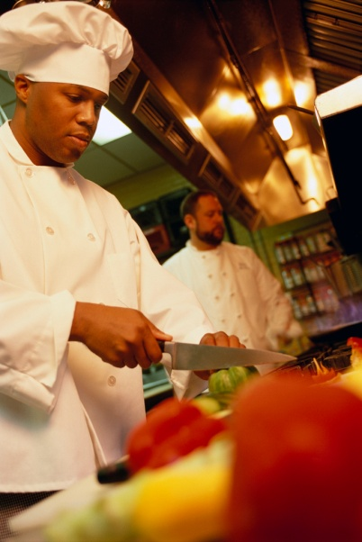
Identify a range of alternative catering systems
The Conventional catering system can be used where service of food is:
Centralised
or
Decentralised
Notes:
Trainer states use of a Conventional catering system can be applied to operations where the service of the food is:
Centralised – that is, food service occurs at or adjacent to the food production area
Decentralised – that is, where the food is transported (by tray, trolley, conveyor belt) to some remote/other location within the same building/business where it is either plated or served.

Slide 66
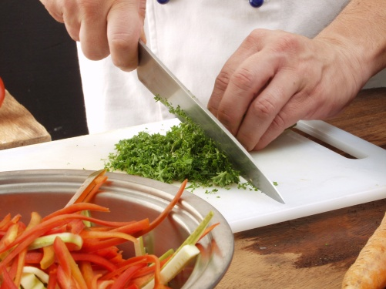
Identify a range of alternative catering systems
The Ready-prepared system comprises:
Food prepared on-site
On-site storage:
Under refrigeration – ‘cook-chill’
Under frozen storage – ‘cook-freeze’
Re-thermalisation – on-site, as and when required
On-site service
Notes:
Trainer introduces the Ready prepared catering system stating it focuses:
On preparing food on-site
Storing it on-site – under refrigeration or frozen storage
Re-heating it on-site – when required, for
On-site service.

Slide 67

Identify a range of alternative catering systems
Food for use in the Ready prepared system may be bought:
As raw fresh ingredients
Partially pre-prepared
Ready-made
Notes:
Trainer states as with the Conventional system the food which is processed/cooked may be purchased across all points of the food processing continuum as:
Raw ingredients – requiring full processing (preparation and cooking)
Pre-prepared food – requiring no or partial preparation prior to cooking/inclusion in menu items
Ready-made items – only needing to be cut/portion-controlled, plated and served.

Slide 68
Identify a range of alternative catering systems
Stages in the ‘cook-chill’ system:
Food is produced
Food is packaged
Cooked is rapidly chilled
Food is stored under refrigeration
Food is re-heated as required
Food is held for plating and service
Notes:
Trainer describes the stages of ‘cook-chill’ as being:
Food is produced – by standard or bulk-cooking methods (such as the use of kettles or cook tanks)
Food is packaged (using an automated pump system or a manual-filling option [hand-held jug or ladle]) – in a variety of containers but commonly into a range of durable, vacuum-sealed plastic bags catering for individual serve sizes up to larger volume/bulk packs
Cooked food is rapidly chilled – using blast chilling, ice slurry tumblers or iced water bath causing food to reduce from cooking temperatures to 5˚C or less in 90 minutes
Food is stored under controlled refrigerated conditions – in the range of -2˚C to 0˚C for periods of up to seven weeks
Food is re-heated as required – using options including:
Steamers
Braising pans
Microwave ovens
Kettles
Combi-ovens
Food is held for plating and service.
Class Activity – Excursion
Trainer arranges visit to a venue using the Cook-chill catering system so students can:
Observe food production, packaging, storage and re-heating
View facilities
Watch food service
Talk to management
Talk with staff.
Class Activity – Online videos
Trainer facilitates the viewing and discussion of online videos such as:
http://www.youtube.com/watch?v=jAbFCLNnpvc ‘How to Cook-Chill: Cook-Chill Technology (1 minute 57 seconds)
http://www.youtube.com/watch?v=8qJtWN5Tr8w ‘The Cook Chill Process’ (8 minutes 12 seconds)
http://www.youtube.com/watch?v=nnsPHhuhk90 ‘Regethermic Cook Chill System’ (9 minutes 46 seconds)
http://www.youtube.com/watch?v=8yLZ9EpwO3w ‘Cook Chill Food System: D C Norris & Company Ltd (7 minutes 33 seconds)
http://www.youtube.com/watch?v=kYbNszCCi1g ‘The Cook-Chill Process’ (8 minutes 18 seconds)
Note: videos may need to be watched twice for students to get the most from them.

Slide 69
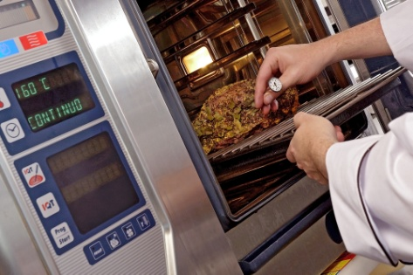
Identify a range of alternative catering systems
Stages in the ‘cook-freeze’ system :
Food is produced
Food is packaged
Cooked is rapidly frozen
Food is stored under controlled freezer conditions
Food is thawed when required
Food is re-heated
Food is held for plating and service
Notes:
Trainer describes the stages of ‘cook-freeze’ as being:
Food is produced which is ‘almost cooked’ – by standard or bulk-cooking methods (such as the use of kettles or cook tanks)
Food is packaged (using an automated pump system or a manual-filling option [hand-held jug or ladle]) – in a variety of containers but commonly into a range of durable, vacuum-sealed plastic bags catering for individual serve sizes up to larger volume/bulk packs
Cooked food is rapidly frozen – using blast freezers causing food to reduce from cooking temperatures to -20˚C or less in 90 minutes
Food is stored under controlled freezer conditions – in the range of -20˚C for months
Frozen food is thawed (to 0˚C to 4˚C) prior to re-heating – under strict time-temperature controlled conditions
Food is re-heated as required – using options including:
Steamers
Braising pans
Microwave ovens
Kettles
Combi-ovens
Food is held for plating and service.
Class Activity – Excursion
Trainer arranges visit to a venue using the Cook-freeze catering system so students can:
Observe food production, packaging, storage, thawing and re-heating
View facilities
Watch food service
Talk to management
Talk with staff.

Slide 70
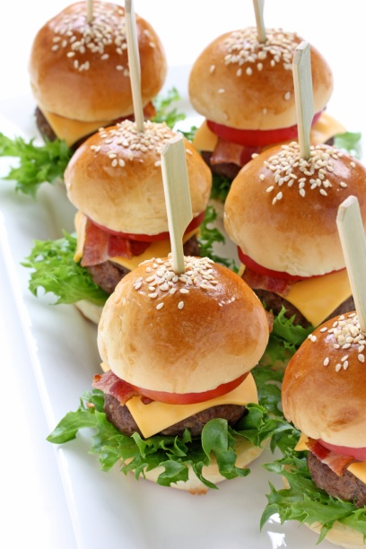
Identify a range of alternative catering systems
In the Commissary system:
Food is cooked in bulk in a central kitchen
Food is distributed (hot, cold or frozen) to satellite kitchens (‘commissaries’) – may be transported:
In bulk
In portion-controlled units
(Continued)
Notes:
Trainer introduces the Commissary catering system stating it is one where food:
Is produced in bulk in a central kitchen
Is then distributed (usually hot and/or cold but may be frozen) to other locations (satellite kitchens, or commissaries) remote from the main kitchen – food may be transported:
In bulk
Portion-controlled (individual/single serves) – pre-plated for service.
Class Activity – Excursion
Trainer arranges visit to venue/s using the Commissary catering system so students can:
Observe food production and distribution
View facilities
Watch food service
Talk to management
Talk with staff.

Slide 71
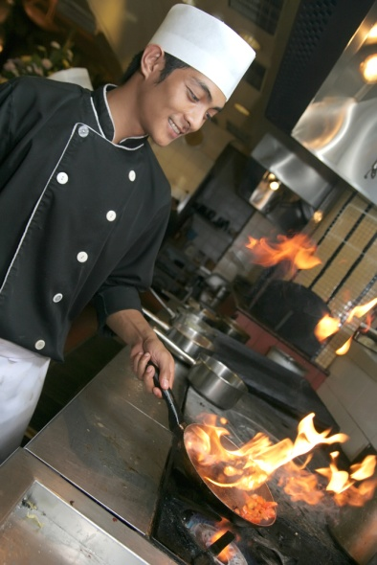
Identify a range of alternative catering systems
Satellite kitchens may be:
Close or distant
When delivered to satellite kitchens cooked food may be:
Served immediately or stored for later use
(Continued)
Notes:
Trainer continues providing information about Commissary system:
Satellite kitchens to which food is transported may be:
Relatively close/local
At a significant distance.
When the food arrives at the satellite kitchens it may be:
Served immediately, and/or
Stored – under refrigeration or in freezers, and re-heated/used as necessary.

Slide 72
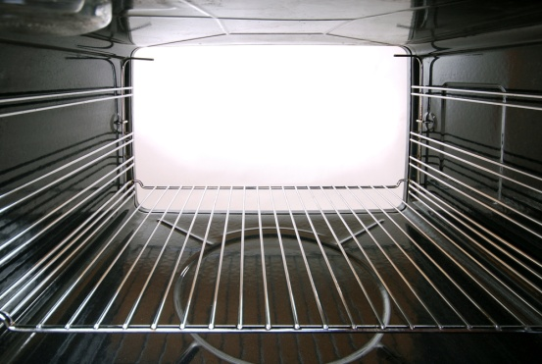
Identify a range of alternative catering systems
Very little equipment required in satellite kitchens:
Re-heating equipment
Display and service equipment
Notes:
Trainer continues providing information about Commissary system:
Traditionally the satellite kitchens require little or no food equipment apart from
Re-heating units
Food display and service equipment – to assist with food service

Slide 73
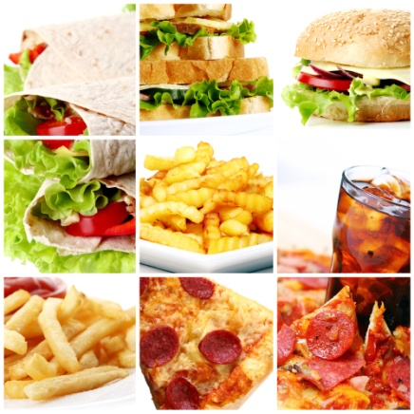
Identify a range of alternative catering systems
The Assembly-serve system:
Not suitable for commercial outlets
Features purchase and receival of prepared dishes
Storage of prepared items under:
Refrigeration
Frozen storage
(Continued)
Notes:
Trainer introduces the Assembly-serve catering system stating it is one where food:
The assembly/serve system is not commonly suitable for commercial outlets.
It features:
Purchase of prepared dishes/menu items – from suppliers
Storage of pre-prepared items on the premises – as appropriate to each item. under:
Refrigeration
Frozen storage

Slide 74
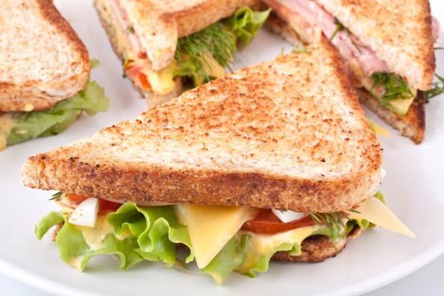
Identify a range of alternative catering systems
Only basic food activities are required:
Portioning
Plating
Re-heating
Service
Notes:
Trainer continues describing the Assembly-serve system:
Only basic food activity in relation to the pre-prepared menu items – such as:
Portioning
Plating
Re-heating
Service.
Class Activity – Excursion
Trainer arranges visit to a venue using the Assembly-serve catering system so students can:
Observe food receival, storage, portioning and re-heating
View facilities
Watch food service
Talk to management
Talk with staff.

Slide 75
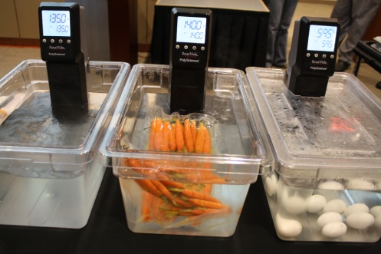
Identify a range of alternative catering systems
Sous vide (Fr) = ‘under vacuum’.
The sous vide approach:
Stores goods under refrigeration
Vacuum seals product or meals:
Under appropriate pressure depending on type of product
(Continued)
Notes:
Trainer introduces sous vide:
Sous vide (French) = ‘under vacuum’
The sous vide approach:
Requires raw ingredients to be stored under refrigeration – and to be cold (3˚C) when vacuum sealed
Vacuum packs raw food into individual bags – at different pressures depending on the type of product: for example delicate fish would be packed at a lower pressure than a hard, root vegetable.
Class Activity – Online videos
Trainer facilitates the viewing and discussion of online videos such as:
http://www.youtube.com/watch?v=5PbnRF-ePnI ‘Tucs combination chiller-cook chill sous vide processor’ (4 minutes 23 seconds)
http://www.youtube.com/watch?v=5WuHddsoV70 ‘Sous vide lamb rack with infused reduction sauce & sautéed vegetables’ (8 minutes 45 seconds)
http://www.youtube.com/watch?v=Rl-msqKc_YQ ‘Sous vide’ (6 mins 41 seconds)
Note: videos may need to be watched twice for students to get the most from them.

Slide 76
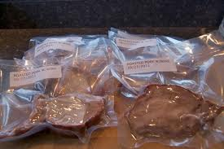
Identify a range of alternative catering systems
Requires vacuum sealed food to be:
Cooked and served immediately, or
Stored at or below 1˚C
Cooks food in the bag in hot water at relatively low temperatures for extended time
Is seen as an adjunct rather than a total system
Notes:
Trainer continues describing sous vide approach:
Demands vacuum packed food is either immediately:
Cooked and served
Stored at or below 1˚C
Cooks the food in its plastic bag using an immersion circulator – operating at lower than normal temperatures (for example, 60˚C to 65˚C) but for longer periods thereby producing (especially for meats and meat products) a better quality result
Is regarded by most as an adjunct to traditional food production options – more so than as a totally alternative system across their entire menu.
This means kitchens that use sous vide will use it for certain dishes they believe respond well to the approach, but not for all menu items.
Class Activity – Excursion
Trainer arranges visit to a venue using sous vide so students can:
Observe food packaging and processing
View facilities
Watch food service
Talk to management
Talk with staff.

Slide 77
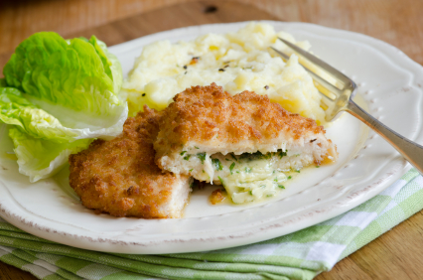
Identify a range of alternative catering systems
Kitchens may use a Combination approach where:
Main ingredient on a plate may be cook-chill
Vegetables may be coked-to-order, for the session
Sauce may be cook-chill
Some menu items may be cook-freeze, some may be sous vide and some may be bought-in ready-to-serve
Notes:
Trainer identifies the reality of some workplaces means a Combination approach may be taken in which, for example:
The primary ingredient on the plate may be cook-chill
The vegetables may be cooked that day/for the session
The sauce may be cook-chill
Certain menu items may be cook-freeze
Other dishes may be sous vide
Some menu items may be fully-prepared and ready-to-serve.

Slide 78
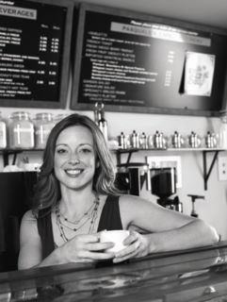

Evaluate agreed enterprise requirements against systems
When evaluating systems KSC must form the basis.
This means you:
Must establish them at the start
Must know what the KSC are
Must keep them central to all analysis
Notes:
Trainer notes it is essential to evaluate the catering systems being considered against the requirements and constraints identified in the planning process highlighting the Key Selection Criteria must form the basis of all evaluations and this highlights the need to:
Comprehensively establish these criteria at the beginning of the catering selection research process – so there is certainty about what is required
Know and understand what the specifics of these criteria are
Keep these KSC central to all considerations and analysis.

Slide 79

Evaluate agreed enterprise requirements against systems
Evaluation is a process of comparison which:
Compares what is available to what is required
Judges the extent of the alignment between what is wanted and what is available
Determines the relative advantages and disadvantages of available options
Notes:
Trainer advises evaluation is a process of comparison stating it comprises three elements which:
Compares what is available against what is required – through asking a series of relevant questions
Judges the degree to which there is alignment between requirements/constraints and availability
Determines the relative advantages and disadvantages of available options.
Class Activity – Guest Speaker
Trainer arranges for manager/owner of suitable business to attend and:
Discusses the process they followed when choosing a catering system by identifying activities they undertook and explaining why they did so
Identifies the people who assisted them
Provides tips and advice to help and allow students to avoid pitfalls
Give examples of Key Selection Criteria they used
Explain rationale for the final selection they made.

Slide 80
Evaluate agreed enterprise requirements against systems
Keys in undertaking an evaluation:
Consider all relevant factors
Allocate sufficient time for the process
Use a team of people
Document thoughts and findings
Notes:
Trainer highlights keys in undertaking an evaluation are:
Consider all relevant factors/criteria – not just one or two, or ‘most’ of them
Allocate sufficient time for evaluation – never rush this stage of the process
Use a team of people to undertake the evaluation – as opposed to doing it on your own
Document your thoughts and findings – never rely solely on memory to provide a foundation for discussion and decision making.

Slide 81
Evaluate agreed enterprise requirements against systems
Factors to consider:
Nature of the operation:
Whether system suits the type of operation
Whether system aligns with market position of the operation
(Continued)
Notes:
Trainer presents factors to consider when evaluating agreed enterprise requirements against systems:
Nature of the operation
Whether the system suits the type of operation being considered:
Is the option going to be effective in the context it is being expected to operate?
Is it acceptable to the customers?
Does it enable the operating and performance targets/goals to be achieved?
Are other (industry leaders) in the sector using this option?
Does a system give the business potential to move into another market/niche?
Whether the system aligns with the market position of the operation:
Does the system fit with public image of the business?
Will the system give the business a competitive advantage/USP which would be useful in the future?
What do customers think of the system and the food it produces?

Slide 82
Evaluate agreed enterprise requirements against systems
The menu:
Whether the intended menu can be produced
Production volume:
Whether the system has the required capacity
(Continued)
Notes:
Trainer continues presenting factors to consider when evaluating agreed enterprise requirements against systems:
The menu
Whether the intended menu can be produced:
Is the system appropriate to the food/quality standard required?
Can all identified menu items be produced and served using the system?
Does the system have the capability to expand to offer/produce other types of dishes, cooking styles and/or cooking methods?
What new menu items (or food types) can be offered/produced using a certain system?
Production volume
Whether the system has the required capacity:
Will the system be able to cope for identified peak demands on an hourly, sessional and/or daily basis?
Does it have the potential to be supplemented by extra equipment to enable capacity to grow if demand increases?
Will the system deliver production volume requirements for events/functions, as well as cater for other known demand at the same time?
What new/extra capacity does a system bring to the kitchen?

Slide 83

Evaluate agreed enterprise requirements against systems
Service areas, service points
Whether food service potential meets requirements
Storage and holding:
Is pre-production storage sufficient?
Is post-production storage sufficient?
(Continued)
Notes:
Trainer continues presenting factors to consider when evaluating agreed enterprise requirements against systems:
Service areas/service points
Whether food service potential meets requirements:
Can the menu items be served in accordance with operator standards and at the required service outlets/points?
Will required service numbers be achieved in the given timeframes for service?
Does food service reflect identified customer preferences for service?
Are suitable food transportation/distribution facilities and/or resources available/affordable to support the system?
Does a system open up new opportunities for fresh service points/outlets?
Storage and holding
Whether pre-production storage is sufficient to meet expected demand:
Are dry goods stores, cool rooms and freezers available as/if required?
Are they of sufficient size/capacity?
Are they located to facilitate the flow of goods/foods within the kitchen/food production area?
What extra capacity does a new/alternate system offer?
Whether post-production storage is sufficient to meet expected demand:
Is there capacity to hold sufficient hot food for service and storage, as required?
Is there capacity to hold sufficient cold food for service and storage, as required?
Is there capacity to display hot and cold food, as required?
What extra capacity does a new/alternate system offer?

Slide 84
Evaluate agreed enterprise requirements against systems
Nutritional and dietary requirements:
Whether food produced will meet nutritional content requirements
Whether system will allow production of diet-specific meals
Available space:
Does system fit available space?
(Continued)
Notes:
Trainer continues presenting factors to consider when evaluating agreed enterprise requirements against systems:
Nutritional and dietary requirements
Whether the food produced meets guidelines for nutritional content:
What proof/evidence is there the required nutritional content can be obtained?
What additional nutritional content can be attained using certain systems?
How is this data obtained and who generates it?
What on-going/on-site checks can be done to verify nutritional content?
Whether the system allows the production of identified/required menu items to enable provision of identified diet-specific meals:
What menu items for specific diets can be produced?
What extra menu items can be produced using certain systems?
Available space
Whether the system fits the allocated space:
Do all elements of the entire food production system fit into the space available for all stages of food production (receiving, pre-production storing, preparation, cooking, post-production storing)?
Do all elements of the entire food production system fit into the space available for all stages of food service (service, holding, display, distribution)?
What extra space/are is required?
What space saving has been made?

Slide 85
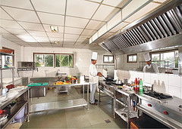
Evaluate agreed enterprise requirements against systems
Ingredients purchased:
Whether system impacts ingredients purchased by the kitchen
Enterprise practices and standards:
Whether system will cause change to practices and standards, and is this change acceptable?
(Continued)
Notes:
Trainer continues presenting factors to consider when evaluating agreed enterprise requirements against systems:
Ingredients purchased
Whether the system impacts the ingredients purchased by the venue/kitchen:
How does each system impact the current way the kitchen orders/purchases ingredients/food?
Will more fresh food/ingredients be required?
Will more pre-prepared/ready-made foods be required?
How does this fresh-versus-pre-/ready-made dichotomy fit with quality standards and customer perceptions/preferences?
Enterprise practices and standards
Whether systems will impact/affect enterprise practices and standards:
Will existing kitchen/venue SOPs need to change/be re-written?
If so, which ones and to what extent?
Is this change acceptable?
Will existing standards (for food quality and service) need to change/be re-written?
If so, which ones and to what extent?
What new practices, standards and organisational change will need to be introduced?

Slide 86

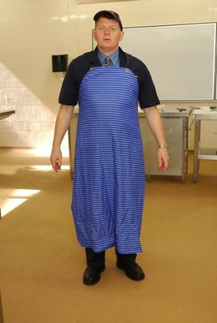
Evaluate agreed enterprise requirements against systems
Financial constraints:
Whether the system aligns with financial parameters set for acquisition
Compliance requirements:
Whether the system meets all identified compliance requirements
(Continued)
Notes:
Trainer continues presenting factors to consider when evaluating agreed enterprise requirements against systems:
Financial constraints
Whether the system aligns with the identified financial parameters for the initiative:
How much do suitable options cost?
What quotations were obtained?
What discounts are available/were negotiated?
How did prices for similar equipment/technology differ between different manufacturers/suppliers?
What financing is available to support the acquisition, and what is the cost of it?
What existing equipment/facilities can be used/re-used as part of the new system?
What revenue can be generated through the sale of equipment being removed to make way for a new system?
Compliance requirements
Whether the system/s meet identified compliance requirements:
Is the system compliant with legislated food safety obligations?
Will the system enable implementation of a HACCP-based FSP?
Will a new FSP be required or will the existing one remain applicable?
Does the system conform with any applicable industry (or other relevant) COPs?
Can the system support implementation of QA as required by the operator?

Slide 87
Evaluate agreed enterprise requirements against systems
Timing constraints:
Whether system can be installed and operational by required date
Operating costs:
Whether the system is viable in terms of on-going costs
Notes:
Trainer continues presenting factors to consider when evaluating agreed enterprise requirements against systems:
Timing constraints
Whether the preferred system can be introduced in accordance with necessary timing limitations:
How long will it take to remove the existing equipment and systems/technology from the food production and service areas?
What impact will this have on trade, cash flow and profit/business viability?
How long will it take to install and commission new systems/technology and equipment?
Does installation and commissioning align with identified operational requirements, or does it create an operational problem in meeting projected demand?
Operating costs
Whether the system is viable in terms of:
What is the cost of staff training to bring staff up-to-speed for the system in all locations/worksites?
Are the projected maintenance/service costs for the system viable?
What potential wastage is predicted and how does this compare to current wastage levels?
How much energy will the system use and at what cost?

Slide 88
Evaluate agreed enterprise requirements against systems
You may have to compromise when deciding what to do – this can mean:
Allowing extra time
Spending more money
Using more space
Buying from a non-preferred supplier
Changing enterprise policies and procedures
Notes:
Trainer explains evaluating may involve compromising explaining this means settling for something less than what was originally needed or wanted and noting while KSC must always form the basis for evaluating options the realities of business life will nearly always require you to compromise.
This may mean you have to:
Extend installation and commissioning dates for equipment beyond preferred timelines
Spend more on the system you will decide to acquire
Use more space than intended to house the system which best serves your needs
Buy from a supplier or manufacturer you did not originally want to deal with
Change enterprise policies, procedures and/or protocols you wanted to remain the same.

Slide 89
Summary – Element 2
When evaluating catering systems:
Identify and research all systems relevant to identified catering requirements and enterprise constraints
Understand the impact and importance of the food processing continuum on various systems
Become familiar with the Conventional system
(Continued)
Notes:
Trainer provides a recap of the Element asking questions to check trainee understanding and responding to questions from trainees, as required.

Slide 90
Summary – Element 2
Know the difference between ‘centralised’ and ‘decentralised’ service
Differentiate between cook-chill and cook-freeze options
Be able to describe the commissary option using satellite kitchens
(Continued)
Notes:
Trainer provides a recap of the Element asking questions to check trainee understanding and responding to questions from trainees, as required.

Slide 91
Summary – Element 2
Understand the assembly-serve system
Note the options provided by the sous vide system
Realise an effective system may use a combination of different approaches
(Continued)
Notes:
Trainer provides a recap of the Element asking questions to check trainee understanding and responding to questions from trainees, as required.

Slide 92
Summary – Element 2
Use Key Selection Criteria and all other relevant factors (including identified constraints) as basis for evaluating catering systems
Involve others in the evaluation process
Ask lots of questions
Document thoughts and findings of this stage of the process
Notes:
Trainer provides a recap of the Element asking questions to check trainee understanding and responding to questions from trainees, as required.

Slide 93
Recommend a catering system
Performance Criteria for this Element is:
Consider the advantages and disadvantages of systems in making recommendation
Notes:
Trainer identifies for trainees the Performance Criteria for this Element, as listed on the slide.
Class Activity – General Discussion
Trainer leads a general class discussion on recommending a catering system by asking questions such as:
Who do you think you would need to make a recommendation to?
What information would you need to cover as part of the recommendation?
How might you deliver/present your recommendations?

Slide 94

Consider advantages and disadvantages of systems in making recommendation
Points to note when making recommendation:
Involve others
Base recommendation on facts
Identify ‘opinion as opposed to ‘fact’
Include details of data collected and considered
(Continued)
Notes:
Trainer advises when relevant catering systems have been identified and evaluated it next remains to make recommendations based on the research and analysis which has been undertaken stressing points to note when making recommendations for the selection of a catering system:
Involve relevant others/stakeholders in the process – do not do it on your own
Base your recommendations on facts identified/learned during the research (identification and evaluation) process – which must reflect the identified requirements and constraints established at the start of the process
Be sure to distinguish and make completely clear any aspects of the report/recommendation which are thoughts and opinions – as distinct from ‘fact/evidence-based’ information
Include details of all classifications of data collected as part of the research/investigative process – qualitative and quantitative data, as well secondary and primary data

Slide 95
Consider advantages and disadvantages of systems in making recommendation
Make a definite clear recommendation
Prepare a written report
Organise a meeting where you make a verbal presentation of your recommendation
Notes:
Trainer continues providing advice regarding making recommendation:
Make a definite recommendation – detailing:
Name/type of system
Manufacturer’s/supplier’s name
Equipment and technology to be used
Dates for strategic action – such as:
Preparing the site/removing existing equipment
Installing and commissioning equipment and systems
Trialling equipment and systems
Supporting/ancillary action – development of new/revised menus and SOPs; advertising; staff training
Costs – including deposits required (and dates), progress payments, acquisition options, funding options and costs, service and maintenance
Prepare a written report – and distribute to the decision makers/management in the organisation
Organise a meeting where you present your recommendations – and:
Speak to/explain your recommendations
Justify/defend your conclusions
Include a Question and Answer session.

Slide 96
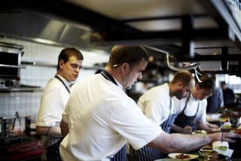
Consider advantages and disadvantages of systems in making recommendation
Advantages of the Conventional system:
Produces higher quality food
Results in greater acceptance by customers
Is familiar to most staff and prospective employees
(Continued)
Notes:
Trainer presents advantages of the Conventional system which may be referred to when making a recommendation:
It produces food of a high quality – but this, of course, is always tied to many other factors too such as quality of initial ingredients, staff skills and expertise, recipes, and available time.
The point being using the conventional system is not a guarantee of high quality food but, generally speaking/all other things being equal it is regarded as producing better quality food than other options – ‘fresh is best’.
The public/customers are well-disposed towards traditional kitchens which cook and serve food in this way – they:
Have confidence in the quality and safety of the food
Prefer fresh-cooked to other forms of food production/service
Appreciate venues where the operations of the kitchen are visible from the dining area
Most cooks, chefs and kitchen staff are familiar with the operations of a conventional kitchen – so this means:
A wider pool of trained and experienced staff to choose from when recruiting/selecting staff
Less need to train staff – because they are more likely to be familiar with and competent in what is required

Slide 97
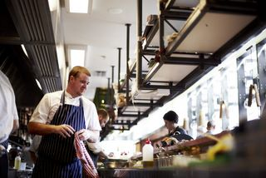
Consider advantages and disadvantages of systems in making recommendation
Provides opportunity for flexibility and responsiveness to demand
Requires less ‘holding’ space for prepared food
Provides potential to produce a wide variety of menu items
Notes:
Trainer continues presenting advantages of the Conventional system which may be referred to when making a recommendation:
The system provides opportunity to be more flexible and responsive to immediate need – for example:
The kitchen can quickly respond to a new (or cut-price) food which becomes available – and have a new dish on the menu and available for service literally within hours
Cooks can cater for special requests from customers on-the-spot, or with very short lead times
Holding/refrigeration and/or freezer space for food is minimised – there is primarily a need to only store food prior to preparation/production and not after it has been produced
The equipment available in an existing conventional kitchen can often be used to prepare/produce a large variety of different menu items – even when the menu changes there may not be a need to purchase new equipment

Slide 98
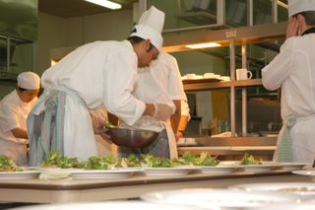
Consider advantages and disadvantages of systems in making recommendation
Disadvantages of the Conventional system:
Higher food cost on a per unit basis
Consistency of finished product can vary
Higher labour costs
Potential need for extra equipment
Potential reduction in food safety
Notes:
Trainer presents disadvantages of the Conventional system which may be referred to when making a recommendation:
Higher foods costs per unit produced – the cooked-to-order approach cannot achieve the (often substantial) economies of scale available through other bulk-food approaches to catering
Consistency of quality is sometimes an issue – as individual dishes can (despite use of standardised recipes for some dishes) result in an unacceptable level of quality in terms of taste, aroma, and appearance
Higher labour costs – the cooked-to-order nature of many foods produced under the conventional system (as well as the traditionally higher costs associated with food preparation prior to cooking – trimming, peeling, cutting, portioning) requires more staff time which translates into more wages needing to be paid
Potential need for extra equipment – while the menu should always dictate the equipment needed in a kitchen the conventional kitchen commonly requires a greater variety of items of equipment, meaning:
Potentially higher initial equipment and on-going running costs
Possible need for a greater kitchen space/area to accommodate all of the required equipment
Potential for reduced food safety – while this is not necessarily a significant concern in all conventional systems it can occur where:
Left-overs occur at the end of food service and they are not stored properly and/or and re-heated
There are inadequate controls over the wide variety of food activities which take place in traditional conventional kitchens and food service areas.

Slide 99
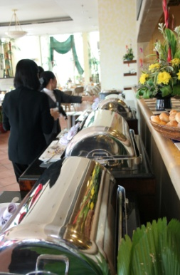
Consider advantages and disadvantages of systems in making recommendation
Advantages of Ready prepared systems:
Reduced costs
Better yield
Address shortages of skilled labour
Produces food of consistent quality
Allows service at any time
Notes:
Trainer presents advantages of the Ready prepared systems which may be referred to when making a recommendation:
Reduced costs – in terms of:
Lower labour cost per unit produced due to economies of scale – meaning a menu item for multiple days of service can be prepared and produced at the one time and then held for (re-heating and) service, as required
Economies of scale related to:
Bulk buying of ingredients
Energy usage
Lower levels of wastage – as:
Left-overs are virtually eliminated
Only required food is removed from refrigerated/frozen inventory thus eliminating over-production by directly matching the type and quantity of food which is re-heated to orders
Better yield from food items – as a result of the cooking processes used which can significantly decrease shrinkage and loss usually attached to other conventional cooking methods
Addresses shortages of skilled labour – through using a system consistent with employing a lower-skilled labour force (compared to hiring highly trained and experienced Chefs)
Produces food of a consistent quality/standard – the techniques, technology and controls (over quantities, times and temperatures in food processing) make for extremely high levels of consistent quality end product
Food service can occur/be available at any time – because the food is already available. It just needs to be re-heated and served.
This provides enormous flexibility in service times and enhances the ability to serve food ‘on demand’.

Slide 100
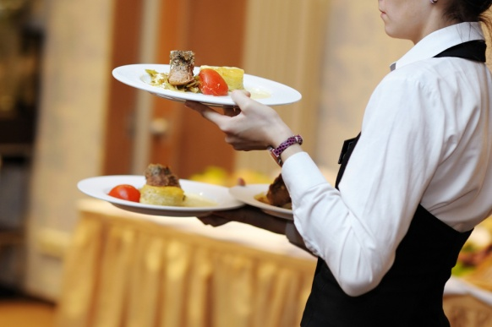
Consider advantages and disadvantages of systems in making recommendation
Disadvantages of Ready prepared systems:
Possible negative customer perceptions and backlash
Perceived possible lower quality of food
Higher establishment cost
(Continued)
Notes:
Trainer presents disadvantages of Ready prepared systems which may be referred to when making a recommendation:
Adverse customer reaction/response – where it is known a business operates this style of service there is frequently a negative backlash from patrons (who prefer ‘fresh cooked’).
If you are operating in an environment where the consumers have no real choice/option (such as a gaol or hospital), this may not be a concern but where you operate in an environment rich with more-preferred catering options it will be a major consideration in your decision-making.
Decreased levels of food quality – this is regarded by some as a ‘fact’ in relation to food produced and served under this system, and regarded by others simply as a customer ‘perception’.
Debate continues regarding the actual levels/standards of food quality in relation to Ready prepared food but the following points appear constant:
The quality of dishes served under this system is improving over time
When questioned customers consistently say they prefer food produced via the Conventional system
Increased establishment costs – there will be a need for higher levels of expenditure when setting up this system to cover:
Larger requirements for storage (refrigerated and frozen) of prepared food
Specialist equipment/utensils and food area for the packaging of food ready for storage following production
Equipment required for re-thermalisation of refrigerated and frozen menu items

Slide 101
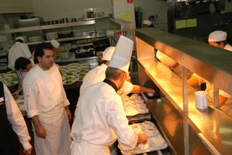
Consider advantages and disadvantages of systems in making recommendation
Potential for limited menu choices
Higher potential loss as a result of ‘out-of-control’ situations
Need to hire (or train) staff with specialist skills
Notes:
Trainer continues presenting disadvantages of Ready prepared systems which may be referred to when making a recommendation:
Potential for limited/restricted menu choices – it is a fact of cooking life that certain dishes do not ‘hold’ and/or re-heat well.
Their appearance, texture and overall quality can be dramatically compromised by holding and re-heating meaning these menu items are unsuitable for this catering system option and can/should not be offered.
Another limiting factor is some cook-chill systems can only process foods which can be ‘pumped’ into storage packaging, limiting their application to (for example) sauces, soups, dressings, stews and casseroles, gravy, pie fillings and mashed potatoes.
Note: some point to the fact the Ready Prepared approach can increase menu choices through holding a wide variety of dishes (under frozen storage) on a single-serve basis and re-heating single units as they are ordered.
Proponents of this line of thought say the same variety of menu items would not be possible under a Conventional system.
Higher loss (or other ‘damage’) potential from an out-of-control food handling event – for example:
An error or problem when producing/cooking an item will result in greater loss of product due to the higher volumes of food being handled at any one time
If a batch of food is contaminated it will affect more people because larger quantities are being prepared at the one time
Need to hire staff with specialist skills or train staff in work roles (tasks and activities) not normally undertaken as part of standard roles and responsibilities under Conventional catering system – such as:
Vacuum sealing food in bags
Operating pasteurising and chilling equipment
Testing pH levels
Preparing and attaching suitable labels to containers/packages placed into storage
Monitoring and controlling times and temperatures of food prior to, and during, refrigerated and/or frozen storage
Operating re-thermalisation equipment.

Slide 102

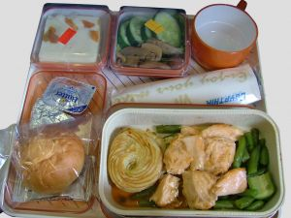
Consider advantages and disadvantages of systems in making recommendation
Advantages of the Commissary system:
Allows central control
Provides reduced need for skilled staff in satellite kitchens
Brings higher productivity in main kitchen
(Continued)
Notes:
Trainer presents advantages of the Commissary system which may be referred to when making a recommendation:
Central control of quality and standards
Reduced need for skilled/high-cost staff in satellite kitchens
Staff at the main kitchen will operate at high levels of productivity – helping reduce costs per unit

Slide 103

Consider advantages and disadvantages of systems in making recommendation
Allows economies of scale
Means little or no need for food processing equipment in satellite kitchens
Facilitates the operation of multiple outlets and service points
Enables main kitchen to be built in least expensive area or location
Notes:
Trainer continues presenting advantages of the Commissary system which may be referred to when making a recommendation:
High volume will bring a range of ‘economies of scale’
No/little need for food processing/cooking equipment in satellite kitchens – may only be a need for storage, re-heating and service equipment
Facilitates the operation of multiple outlets and new service points
Allows main kitchen to be built in an area where (for example) land and building costs are most competitive – as opposed to buying land and building a central kitchen in high-value geographical location.

Slide 104
Consider advantages and disadvantages of systems in making recommendation
Disadvantages of the Commissary system:
Quality-related issues with menu items
Limitations on menu items which can be offered at each outlet or service point
Little ability for satellite kitchens to respond to special requests and customer preferences
(Continued)
Notes:
Trainer presents disadvantages of the Commissary system which may be referred to when making a recommendation:
Quality-related issues – associated with:
Customer/consumer perceptions about loss of quality because food is not ‘freshly cooked’
Actual decrease in food taste, appearance, food safety and nutritional content
Only food produced by central kitchen – or foods bought-in ‘fully prepared’– can be offered
Satellite kitchens cannot respond to individual customer demand or preferences – food is essentially presented/offered on a ‘take-it-or-leave-it’ basis

Slide 105

Consider advantages and disadvantages of systems in making recommendation
Need for highly skilled staff in main kitchen
Requires extra expense in packaging and distribution
Demands additional food safety protocols to be established, implemented and monitored
Notes:
Trainer continues presenting disadvantages of the Commissary system which may be referred to when making a recommendation:
Main kitchen requires highly-skilled, highly-competent staff
Requires expenditure on:
Transporting/distributing the food – such as food transport vehicles (such as vans, trucks or airplanes) and hot and cold food carts
Special packaging for foods
Need for food safety protocols to be developed to cover transportation of food – especially relating to:
Time-temperature controls
Protection of food from contamination
Delivery schedules
Servicing/condition of the food transport vehicle
Actions of the delivery driver.

Slide 106
Consider advantages and disadvantages of systems in making recommendation
Advantages of the Assembly-serve system:
Low levels of equipment required
Less space required
Reduced labour cost
Flexible, ’anytime’ service is possible
Quick service
Notes:
Trainer presents advantages of the Assembly-serve system which may be referred to when making a recommendation:
Low levels of equipment required
Less space required
Reduced labour cost – due to:
Lower levels of skilled staff required
Fewer staff/hours required to provide labour
Service can be flexible/provided ‘at any time’
Service is usually relatively prompt.

Slide 107
Consider advantages and disadvantages of systems in making recommendation
Disadvantages of the Assembly-serve system:
Very limited choice
Totally reliant on others, suppliers
Relatively high food cost
Unable to respond to ‘special requests’
Quality-related issues and perceptions
Notes:
Trainer presents disadvantages of the Assembly-serve system which may be referred to when making a recommendation:
Limited choice of menu items – the outlet can only offer items available from suppliers
Totally reliant on what suppliers can offer and/or deliver
Relatively high food cost – because all menu items are ‘bought in’ as opposed to being prepared from less expensive raw ingredients
No capacity to respond to individual customer need/special requests
Quality-related issues – associated with:
Customer/consumer perceptions about loss of quality because food is not ‘freshly cooked’
Actual decrease in food taste, appearance, food safety and nutritional content.

Slide 108
Consider advantages and disadvantages of systems in making recommendation
Additional topics to address when making recommendation:
Calculation and comparison of costs of outright purchase against other acquisition options (such as leasing) factoring in all relevant issues
Consideration of options and strategies for dealing with equipment breakdown, maintenance and service repair needs
(Continued)
Notes:
Trainer advises in addition to the advantages and disadvantages already identified there will commonly also be a need to address:
Calculation and comparison of costs of outright purchase against other acquisition options (such as leasing) factoring in relevant issues such as:
Taxation implications
Depreciation rates
Cash flow
Cost-Benefit analysis
Consideration of options/strategies for dealing with equipment breakdown, maintenance and service/repair needs – such as:
Service contracts with external providers/service technicians
Maintaining replacement items and parts
Establishing and maintaining an in-house Maintenance department

Slide 109
Consider advantages and disadvantages of systems in making recommendation
Comparison of ‘current’ to ‘projected’ positions and statistics
Relevant costs and timing issues
Required organisational changes
Notes:
Trainer continues advising of additional topics to be covered when making recommendation:
Comparison and contrast of:
Current/previous situation (volume of food produced; costs; wastage; labour; numbers served) to expectations/projections
Costs and timing related to:
Removing existing equipment
Installation of new equipment, systems and technology
Commissioning and testing the system
Organisational changes required – such as:
Requirements for new and/or revised:
Policies and SOPs
Documentation to support QA system and FSP requirements
Menus
Service times
Staff rosters
Ordering and purchasing of raw materials/ingredients
Stock control and management
Internal communication
Need for new/different staff training and induction and orientation for staff
Changed arrangements for:
Determining productivity
Yield testing
Accessibility to raw materials and end-products.

Slide 110

Consider advantages and disadvantages of systems in making recommendation
Activities to assist making recommendation:
Identify date, time and venue for face-to-face presentation
Invite stakeholders and urge them to attend
Circulate formal, written report in advance
(Continued)
Notes:
Trainer presents advice for possible activities to assist in delivering recommendations to management/the decision makers in the organisation:
Identify a date, time and venue for the presentation of your recommendations
Invite all relevant stakeholders to the meeting – urge them to attend by stressing the importance of the meeting
Circulate your written report/recommendations prior to the presentation – so stakeholders have an opportunity to read the material, become familiar with the content, formulate questions they want to ask and identify issues they want to raise

Slide 111

Consider advantages and disadvantages of systems in making recommendation
Include a tour of relevant venue or kitchen
Invite managers and operators from relevant venue to speak at the presentation
Ask suppliers of equipment and systems to attend
Notes:
Trainer continues presenting advice for possible activities to assist in delivering recommendations to management/the decision makers in the organisation:
Include a tour of a venue already using the catering system you are recommending (if possible) – so stakeholders obtain first-hand experience of the system in terms of:
Inspecting facilities and equipment
Identifying flow of food through the venue/kitchen
Observing food preparation and production
Watching food service
Experiencing the food produced
Invite managers and operators from a kitchen/business using the system you are recommending to attend the meeting/presentation – to give their endorsement and opinions of the system
Ask suppliers of the system to attend – and:
Speak to your recommendation
Provide additional detail relating to the proposal
Screen relevant videos/DVDs.

Slide 112
Summary – Element 3
When recommending a catering system:
Involve others in the process
Base recommendations on facts
Prepare and circulate a formal, written report
(Continued)
Notes:
Trainer provides a recap of the Element asking questions to check trainee understanding and responding to questions from trainees, as required.

Slide 113
Summary – Element 3
Organise a meeting to support the written report and to present and explain recommendations
List relevant and relative advantages and disadvantages of catering systems which have been considered
Compare different catering systems against each other as well as identified catering requirements and organisational constraints
Notes:
Trainer provides a recap of the Element asking questions to check trainee understanding and responding to questions from trainees, as required.
Trainer thanks trainees for their attention and encourages them to apply course content as required in their workplace activities.

